Slide 1

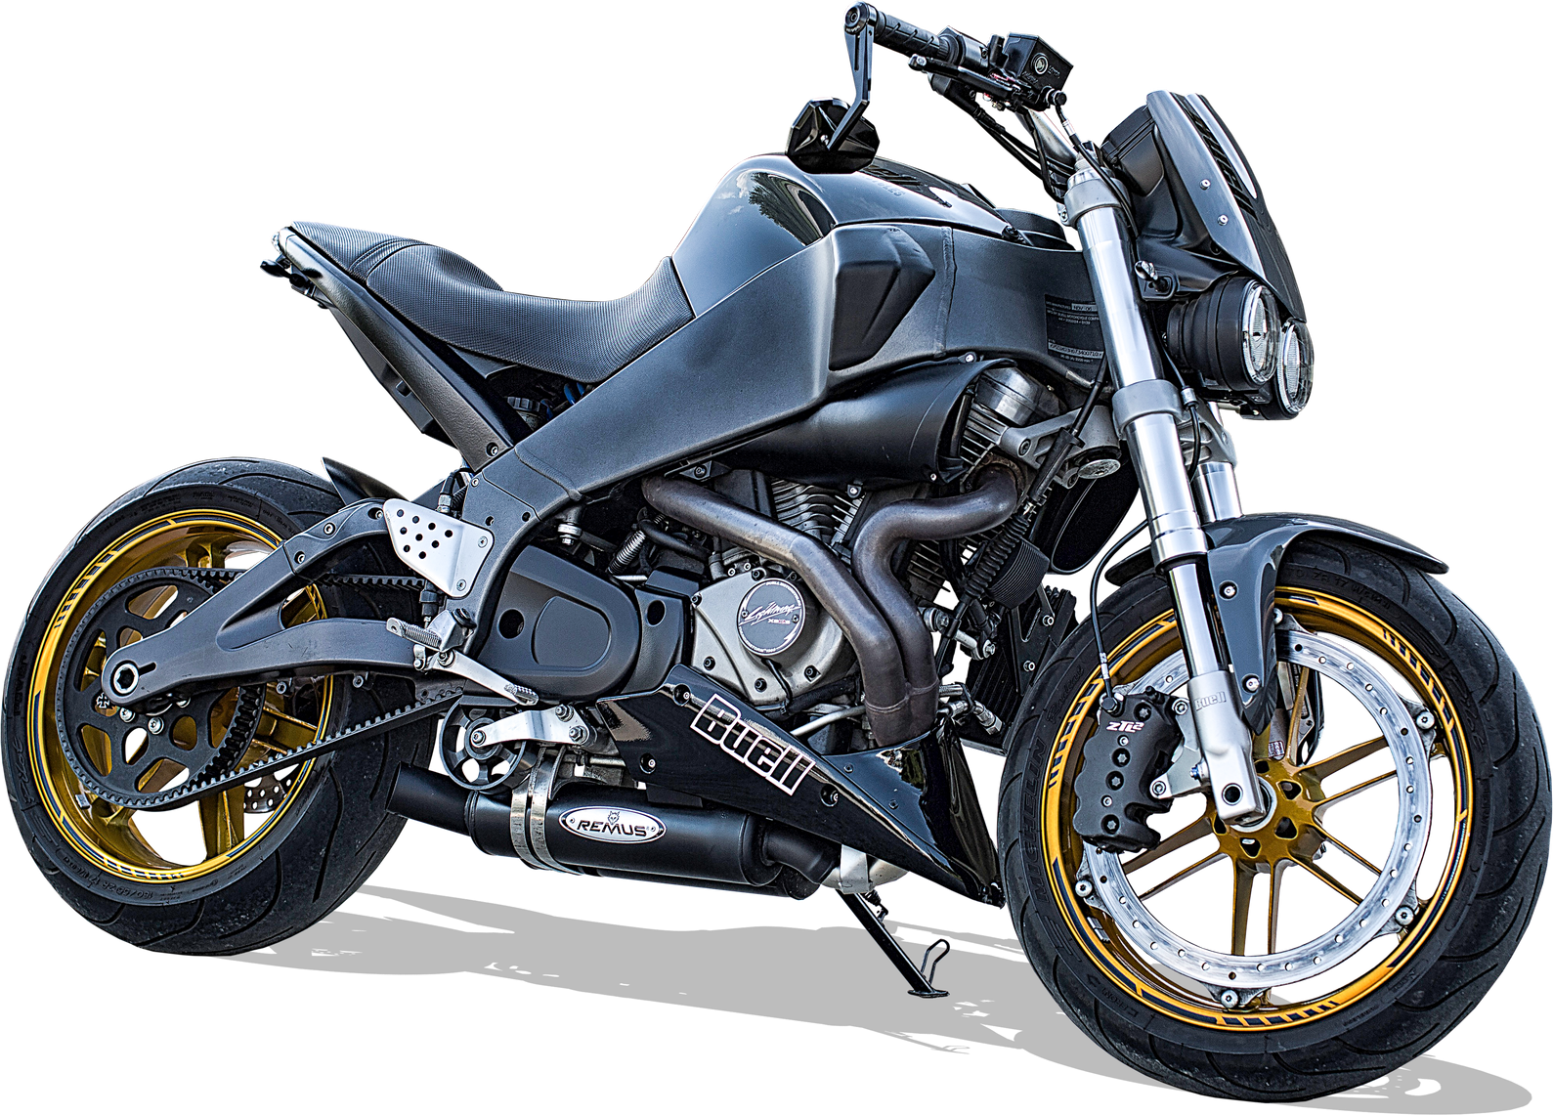


Bike dataset
Gruppo E
Michea C.
Julian C.
Andrea M.
Notes:
Mic

Slide 2

Dataset
Analysis
End
Dataset
From Kaggle, scraped from Bikez.com
~ 38'000 rows, 77 columns
02
Notes:
Mic

Slide 3
Dataset
Analysis
End
How is our dataset structured?
Each row, is a different bike model:
The set contains the price, but not any indications on sales for that model
 | Model | Manufacturer | Year | HP | Displacement_cc | Engine type | Top_speed_kmh
 | BMW F 750 GS | BMW | 2021.0 | 77.0 | 853.0 | Twin, four-stroke | 190.0
03
Notes:
juj

Slide 4
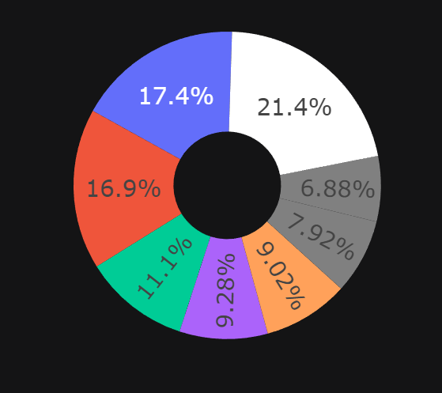
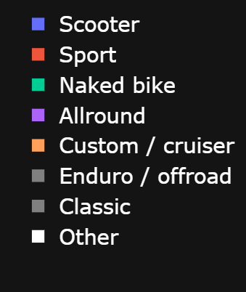
Dataset
Analysis
End
Models by type of bike
04
Notes:
juj

Slide 5
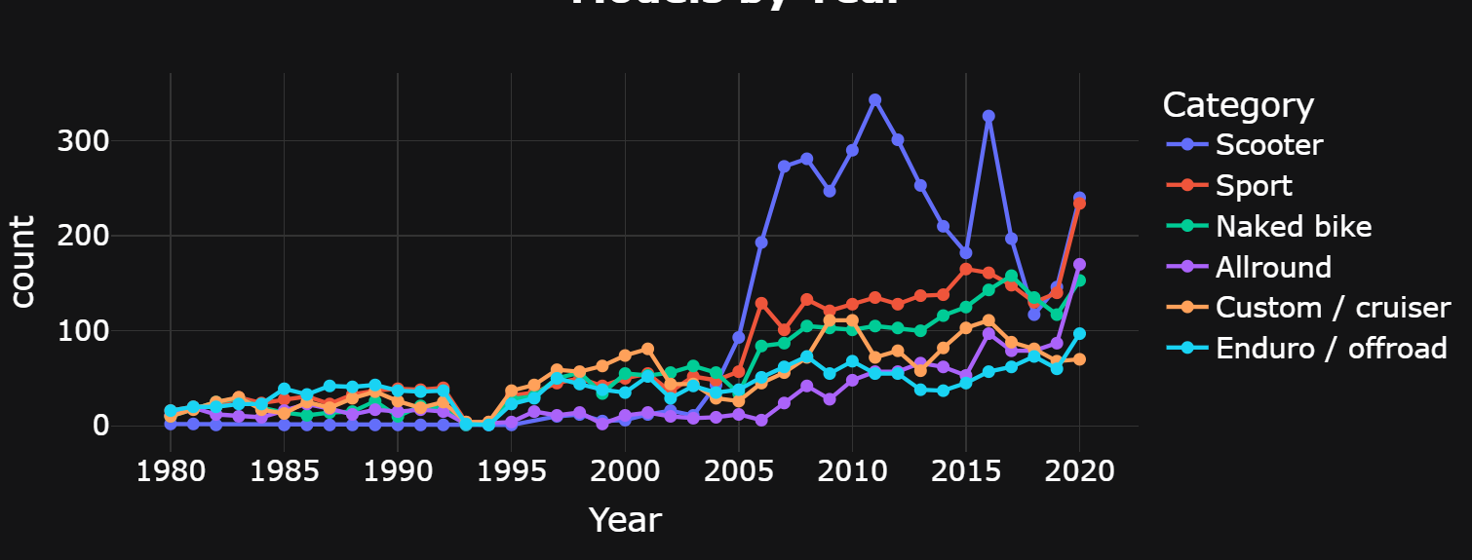
Dataset
Analysis
End
Number of scooters launched exploded
Good compromise for the life in the city
05
Notes:
juj

Slide 6
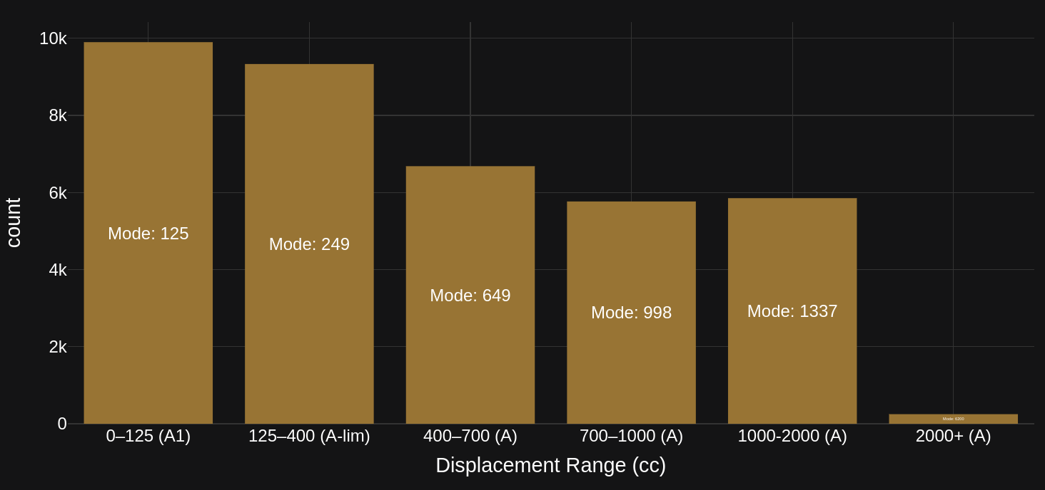
Dataset
Analysis
End
The mode likely shows different bikes with the same engine
Mode: 6200
06
Notes:
Mascio, Le moto con cilindrata più bassa prevalgono, in quanto meno costose e più versatili
La moda ci mostra come probabilmente più moto usano lo stesso motore, visto che hanno la stessa identica cilindrata

Slide 7
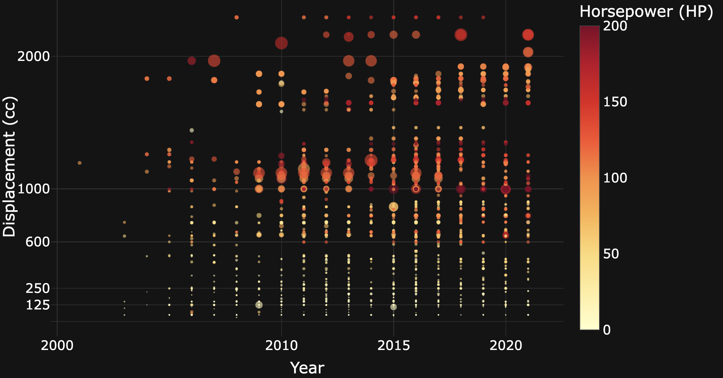
Dataset
Analysis
End
Evolution of Bike HP and CC Over the Years
07
Notes:
Mascio
Da passare relativamente in fretta, spiegare meglio nel grafico successivo

Slide 8
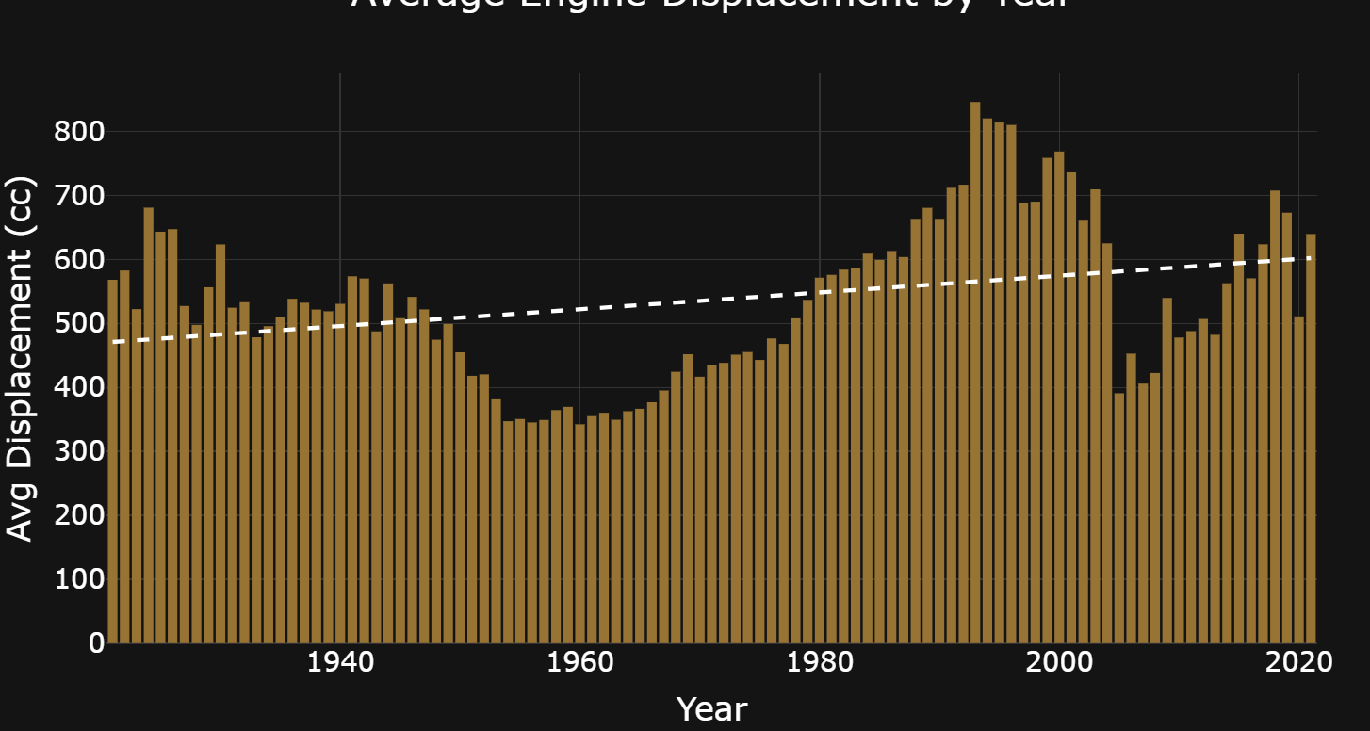
Dataset
In progress
End
Displacement behaves like a “trend”
But generally, increases
08
Notes:
Juj

Slide 9
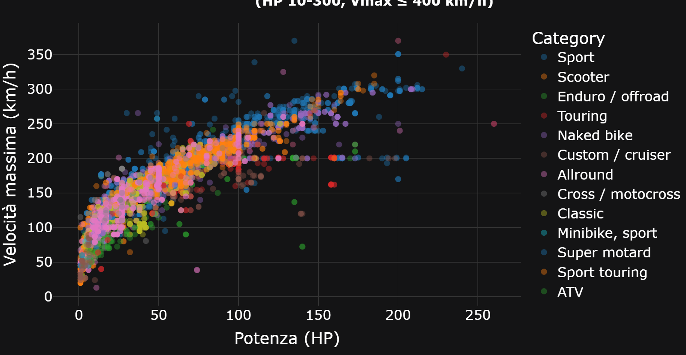
Dataset
HP_CC
End
HP is related to the max speed
10
Notes:
Juj

Slide 10
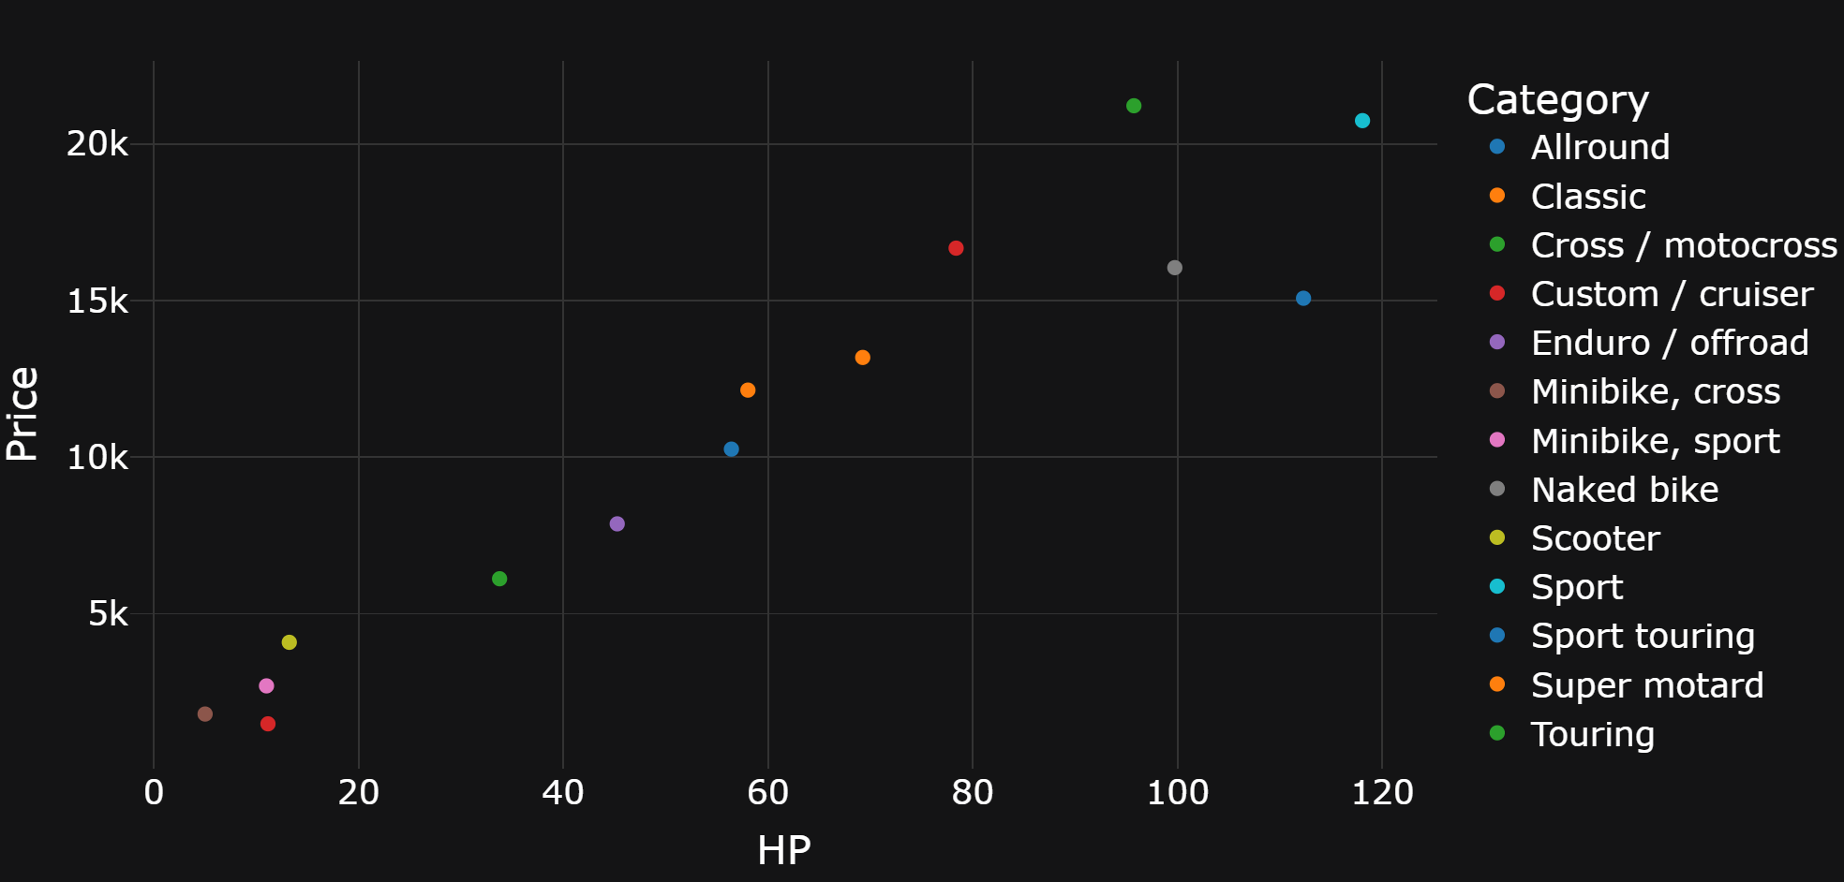
Dataset
Hp_Price
End
More HP does not mean more expensive
09
Notes:
Mic

Slide 11
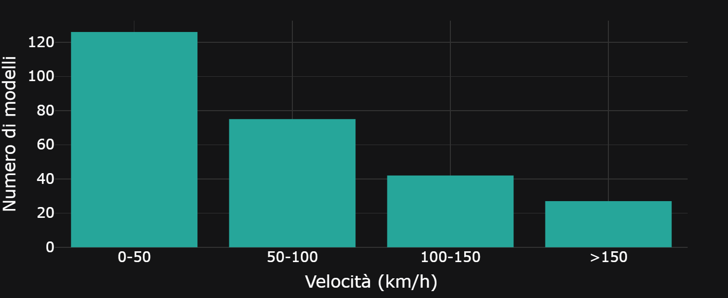
Dataset
Electrics
End
Majority of electric bikes are slow
11
Notes:
Mic

Slide 12
Dataset
Analysis
End
Thank you for your attention
12
Notes:
Mascio

